Slide 1



SAFETY Pillar Board
Ruth Silva
Lima 2022, WCS

Slide 2
Contents
1. Introduction
1.1 Vision, Needs, Objectives & Target
1.2 KPI & KAI
1.3 Rout Map
1.4 Pillar Team – Radar Chart
1.5 Governance and meeting System
2. Implementation Methodology
2.1 Step 1 al 3
2.2 Results
3. SWOT
4. Next Steps
Notes:
Heavier content slide.

Slide 3



VNOT
OBJECTIVES
Cero accidentes
Reducir el LTIR
Reducir el TRIR
VISION
Ser proactivos en disponer un ambiente seguro en los diferentes escenarios de los puestos de trabajo, con el fin de prevenir lesiones y enfermedades ocupacionales.
Ser reconocidos como la empresa más segura del mercado.
NEEDS
Incrementar los reportes de actos y condiciones subestándares.
Asegurar la mejora continua del sistema de gestión de la seguridad.
VNOT
TARGETS
Cero accidentes Reducir en un 10% LT Incident Rate
Reducir en un 10% TRIR respecto al año anterior
Notes:
Heavier content slide.

Slide 4
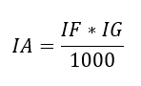
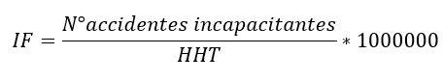
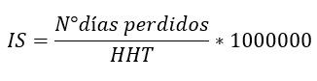
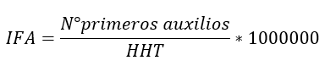
KPI / KAI
Key Performance Indicators
Key Activity Indicators
1. Indice de accidentabilidad
2. Frecuency rate.
3. Lost time rate.
4. First aid rate
Incidents analyzed by SEWO
N° Kaizen
N° SOP
N° OPL
N° Tag Number – Reports (UA-UC)
N° of people involved in Safety pillar
Notes:
Heavier content slide.

Slide 5
1.3 ROUTE MAP
Year
2022
2023-1
2023-2
2024
2025
Pillar Score
Kick Off
2
3
4
5
Methodology and Main Process
Safety KPI
Radar Chart team Safety
Elaboration S-Matrix
Training
Expansión de la metodología al lab EHS.
Automatization the process.
KPIs
1. Indice de accidentabilidad
2. Frecuency rate
3. Lost time Rate
0
0
0
0
0
0
0
0
0
0
0
0
0
0
0
Step
1-3
4-6
7
7
7
Notes:
Heavier content slide.

Slide 6

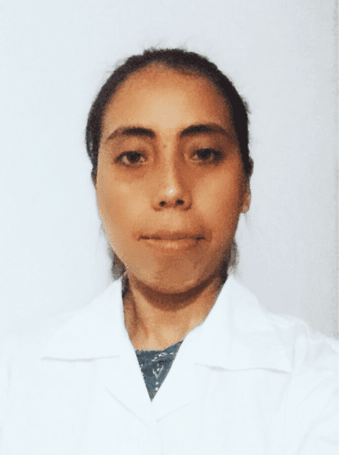


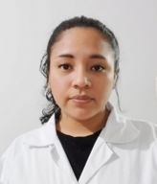

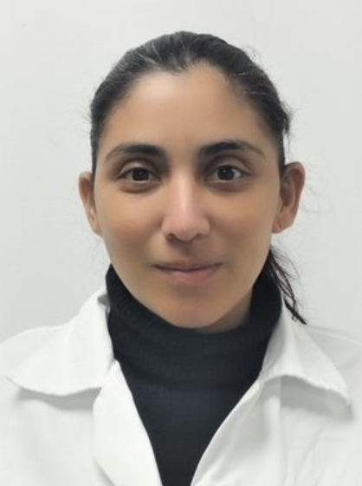
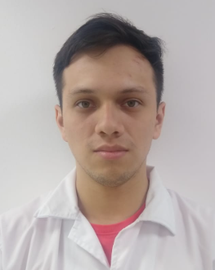
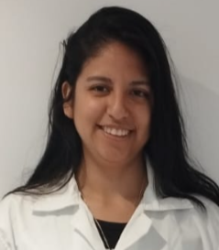

1.4 PILLAR TEAM & RADAR CHART
C
O
R
E
T
E
A
M
Ruth Silva
Coordinador OI
Safety Pillar Leader
Ana Salazar
Analista Senior LAB EHS
Safety Pillar CoLeader
Luis Camargo
Analista LAB EHS
Safety Pillar
Yaco Acuña
Analista LAB EHS
EEM Pillar Leader
Extended Team
Olenka Fiestas
Analista LAB EHS
WO Pillar Leader
Junior Ñiquen
Coor. OI LAB EHS
SAF Pillar Leader
Ana Romero
Analista LAB EHS
LCS Pillar Leader
Juan Vasquez
Analista LAB EHS
AM/PM Pillar Leader
Alessandra Guerrero
Analista LAB EHS
ENV Pillar Leader
Jackelin Pachas
Ingeniero de Procesos y Costos
Group Finances
Notes:
Heavier content slide.

Slide 7
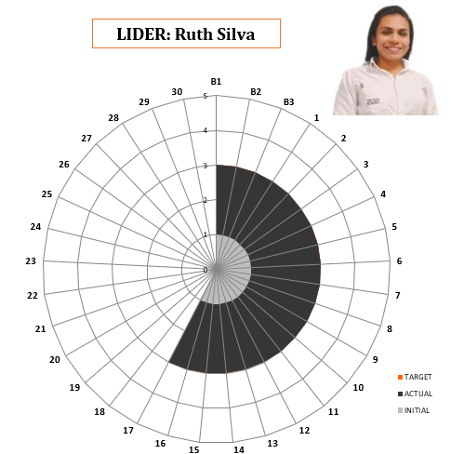
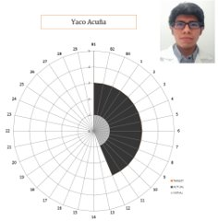
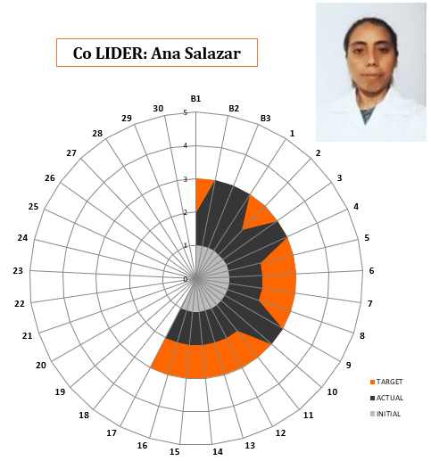
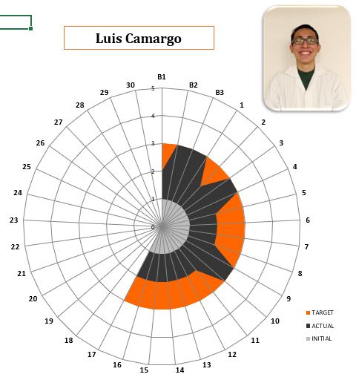
RADAR CHART

Slide 8
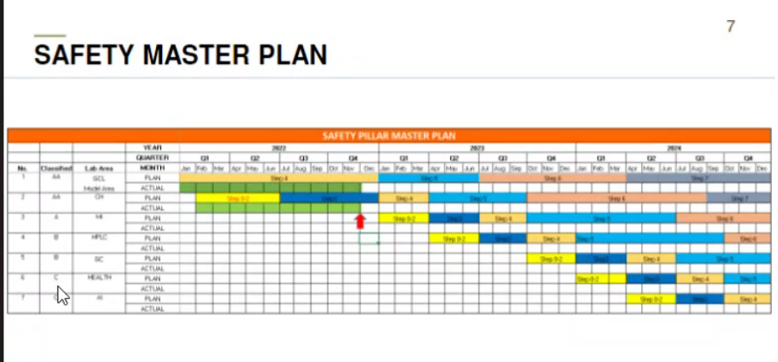
Master Plans

Slide 9
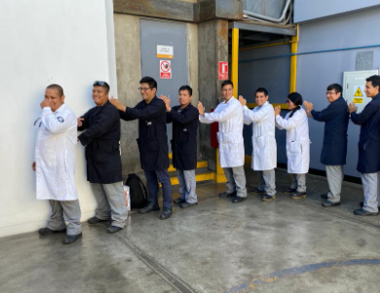
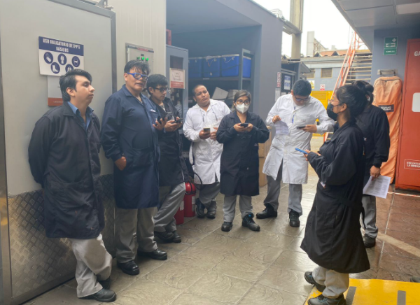
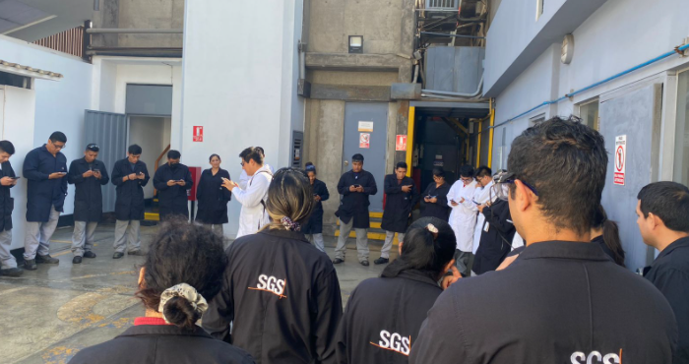
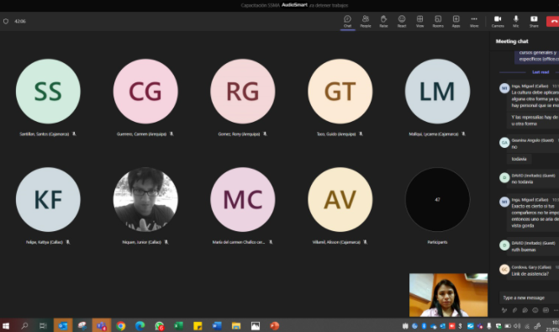
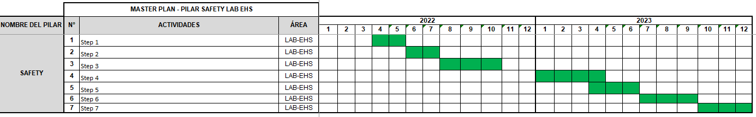
1.5 MASTER PLAN

Slide 10
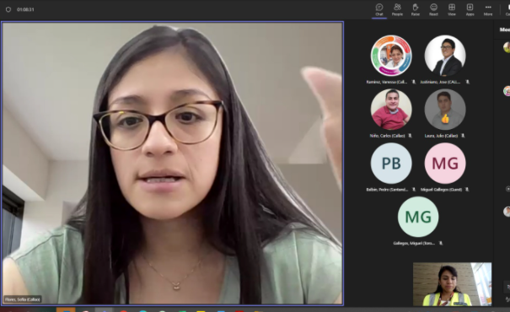
1.6 GOVERNANCE & MEETING SYSTEM
Regarding training, organization, planning and monitoring of activities, the following meetings are held:
Pillar Leaders
Triangle Meeting
Trainings
Dissemination of information.
Projects review
Use of methodologies and tools.

Slide 11
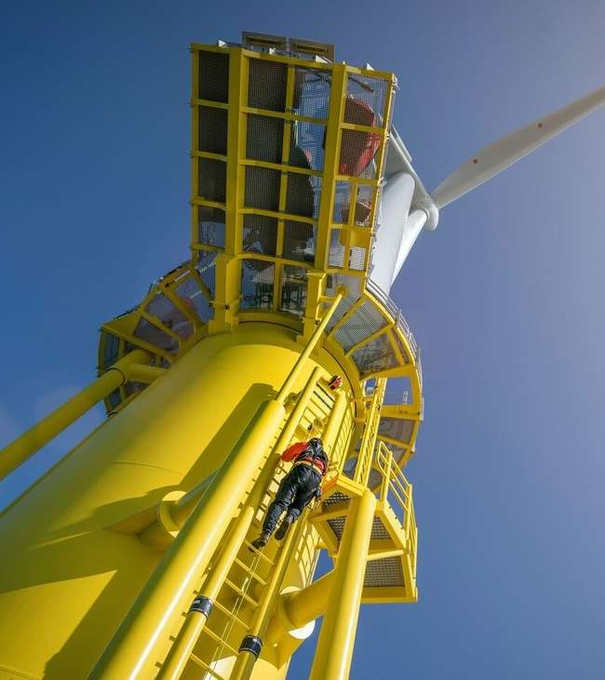
METHODOLOGY- 7 Step APPROACH
Notes:
Section slide.

Slide 12
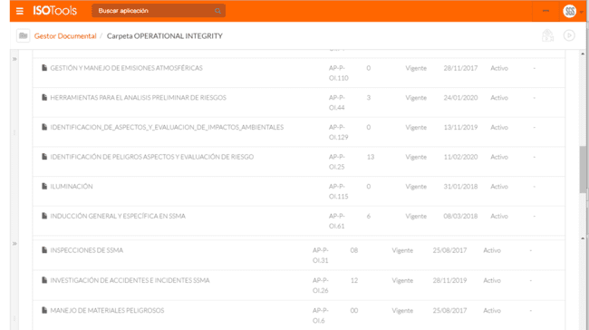
Safety standard Safety documents from SGS Peru are posted on ISOTOOLS

Slide 13
Compliance analysis of legal
OI inicia el proceso de revisión trimestral de requisitos legales
Asesor legal revisa y actualiza requisitos legales SSMA y Salud
15 días
OI realiza 1era revisión
Aprobación Manager OI
Publicación en Isotools y por correo a trabajadores de SGS
Implementación por OI y supervisores de laboratorio.
Sin observaciones
Seguimiento por área legal y gerencia.
Procedimiento D-OI-P40-02

Slide 14
Compliance analysis of legal
Compliance with legal requirements is monitored through registration in the Legal Requirements and Other Requirements Management Matrix. These requirements are of a safety, health and environmental nature.

Slide 15
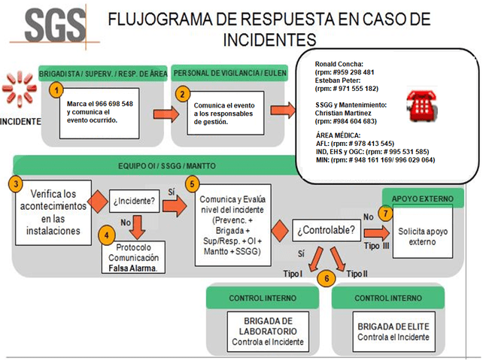
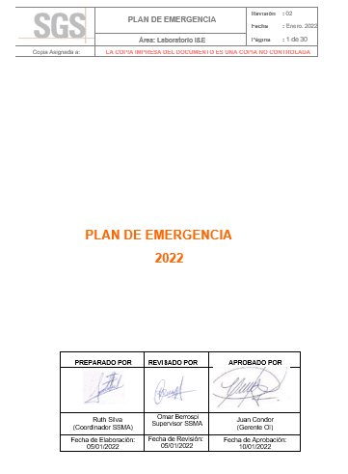
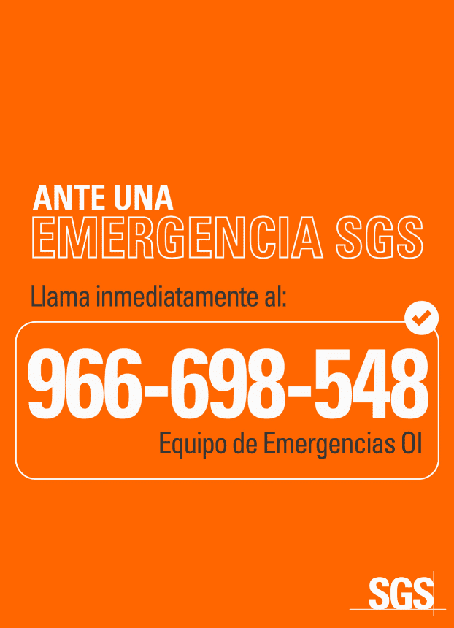
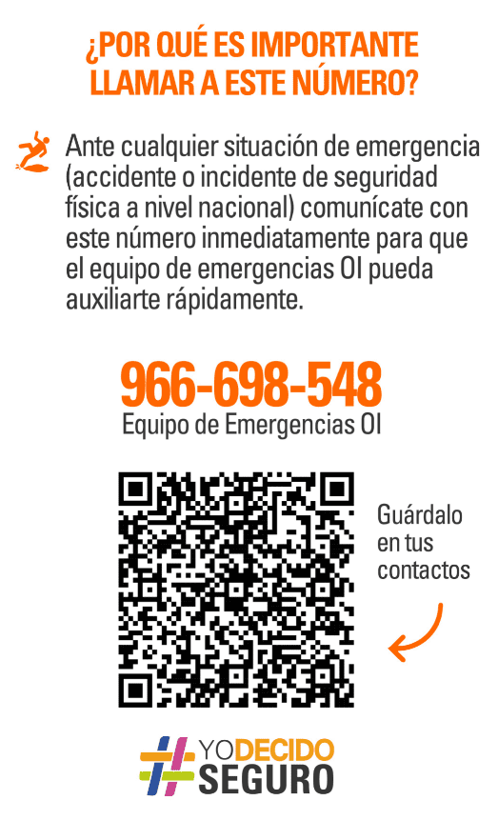
Emergency plan
BRIGADES:
The brigades can be classified
Evacuation Brigades
First Aid Brigades.
Fire Fighting Brigades
Dangerous Materials Brigade
CLASSIFICATION OF EMERGENCIES:
Type I
Type II
Type III

Slide 16
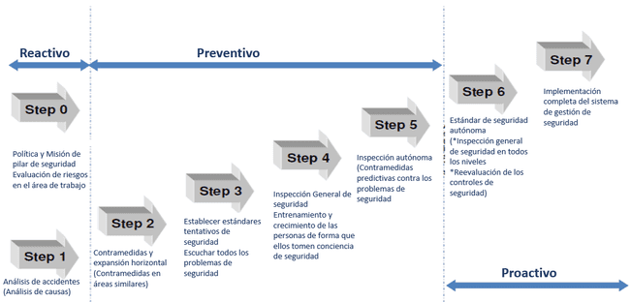
METHODOLOGY- 7 Step APPROACH

Slide 17
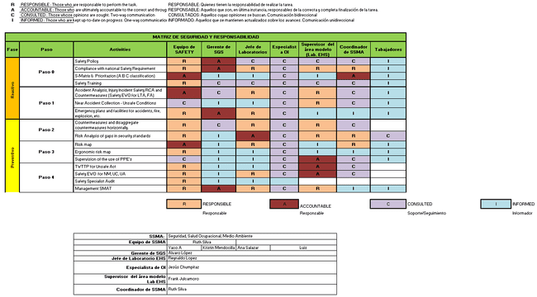

POLICY & Safety responsibility matrix
Prevent incidents, injuries, illnesses and occupational diseases of our collaborators.
Comply with the legal requirements, regulations, others signed by the organization and collective agreements of Safety

Slide 18
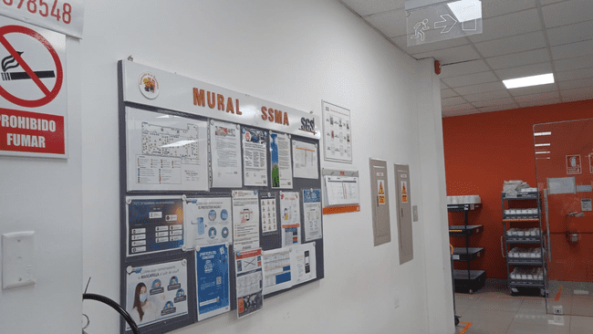
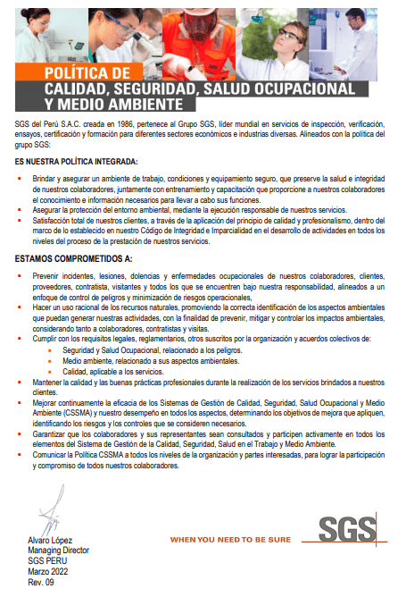
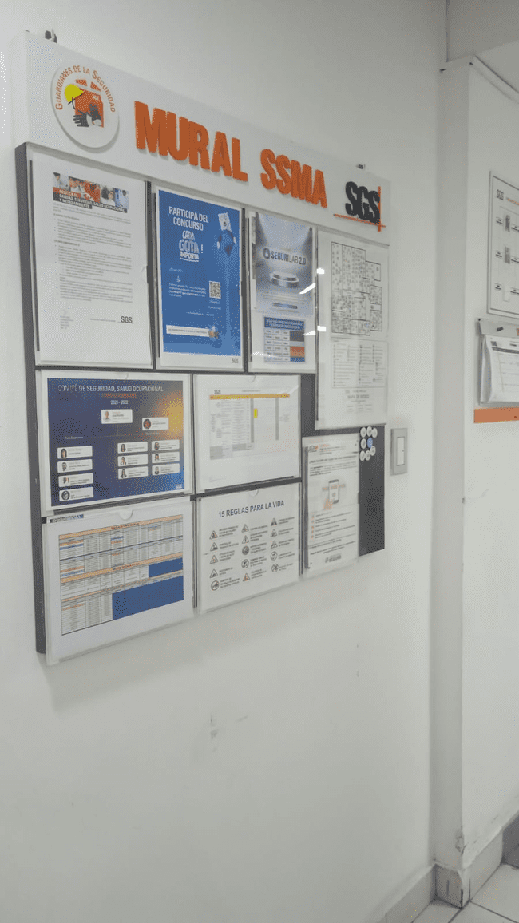
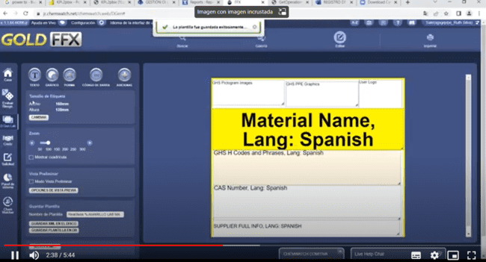
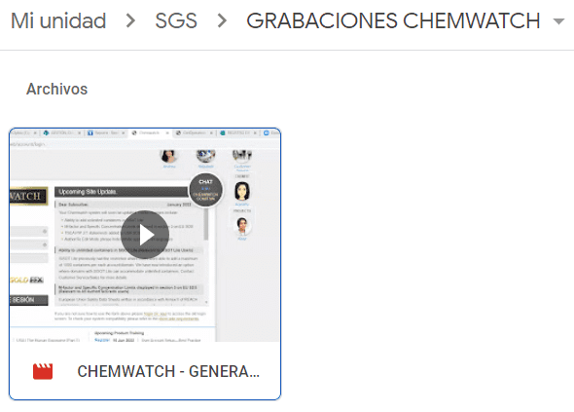
PUBLICITY OF SAFETY REQUIREMENTS
Annual meeting to review compliance with HSE indicators
At the beginning of each year, the OI management establishes the KPI and the annual HSE plan.
Safety Month Campaign in Peru SGS every year held in the month of September, this year the theme was "Zero Tolerance for non-compliance".
Information through app (SGS Campus, Intelex, YME) and emails.
Safety training for new employees: General induction, specific and face-to-face induction.
Monthly meeting of the Occupational Health and Safety Committee made up of the employer and the workers.
Covid-19 protocols.
Incidents within the laboratory.

Slide 19
epp´S Plane

Slide 20
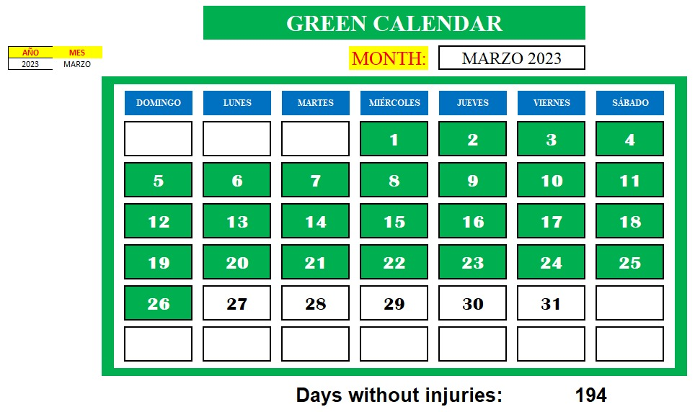
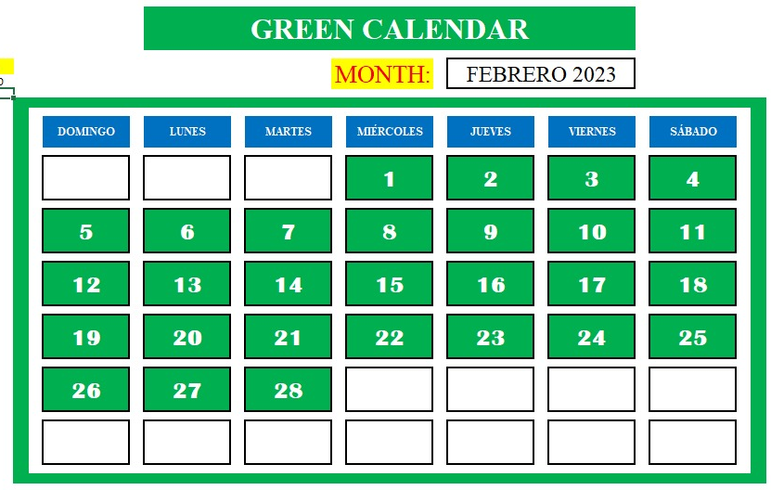
GREEN CALENDAR
Actualizar hasta la segunda semana de marzo

Slide 21
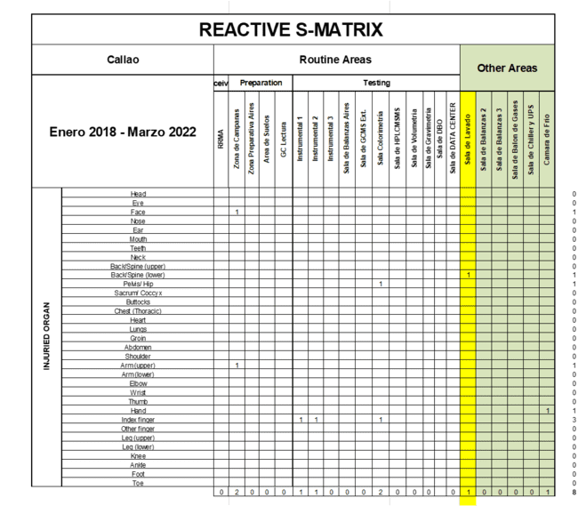
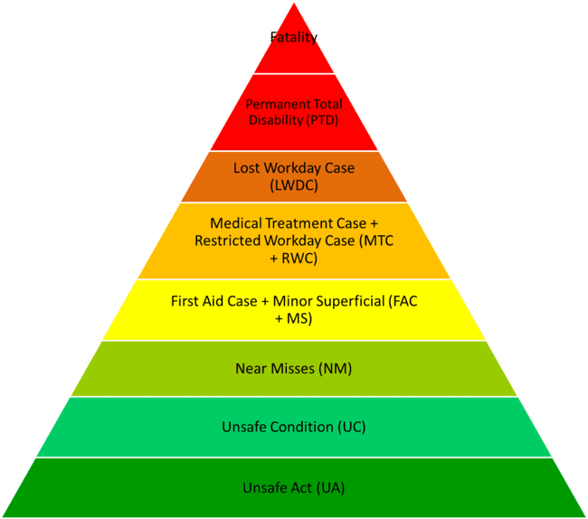
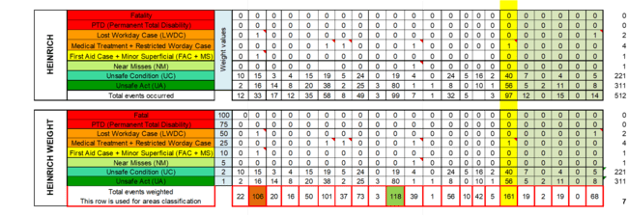
Safety Matrix and area classification
Safety Matrix 2022

Slide 22
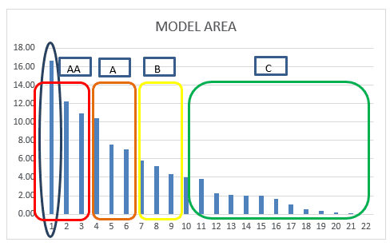
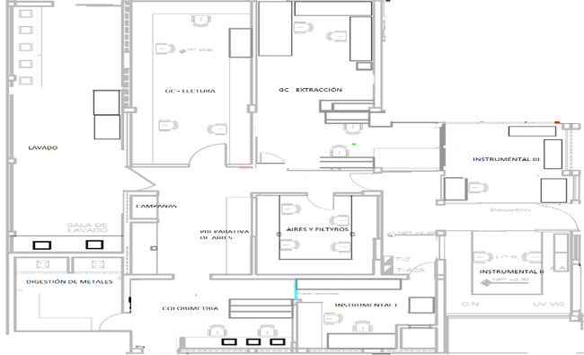
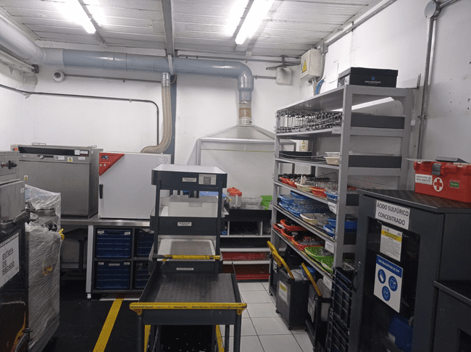
Safety Matrix and area classification
Model Area Map
MA

Slide 23
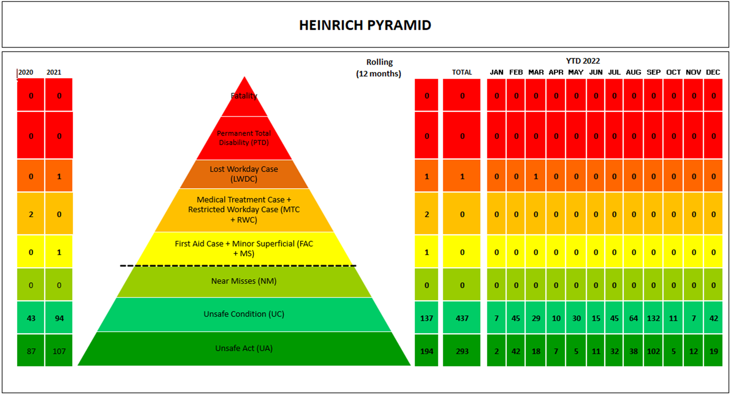
HEINRICH PYRAMID LAB-EHS

Slide 24

HEINRICH PYRAMID: AREA MODELO – AREA DE LAVADO

Slide 25
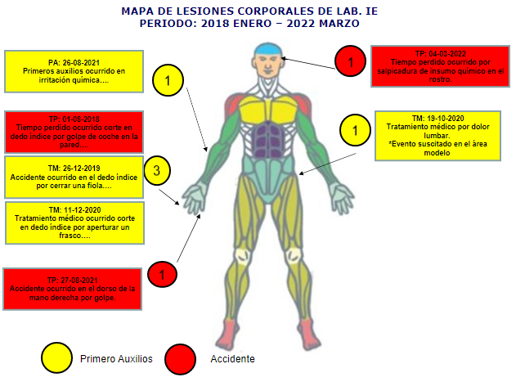
Body Injury Map Lab I&E - EHS

Slide 26
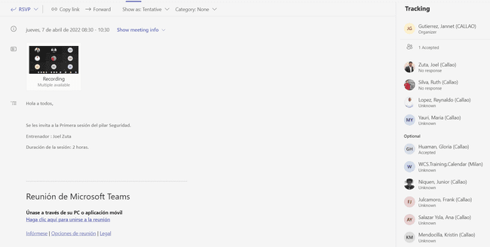
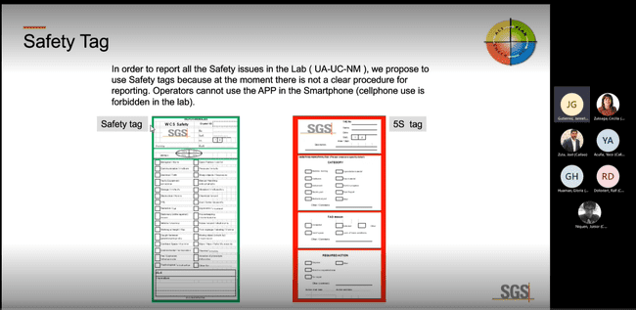
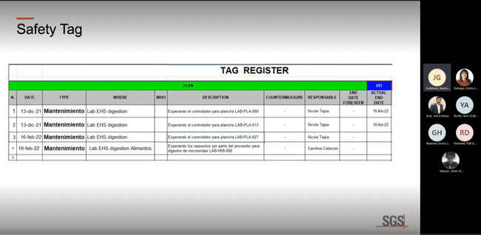
TRAINING - 5S
Trainings in virtual modality by the teams platform.

Slide 27
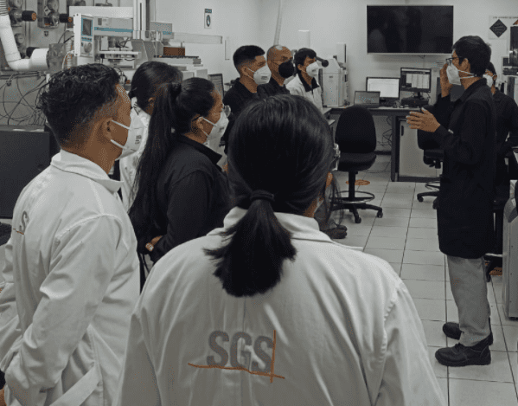
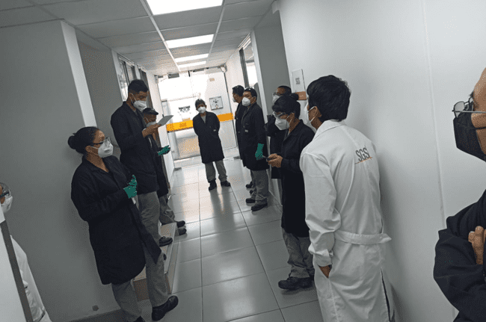
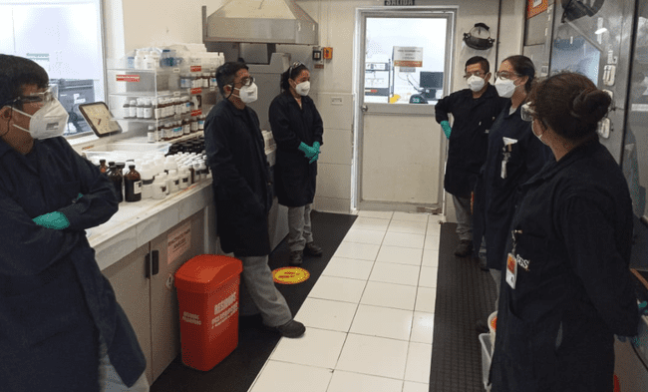
TRAINING - 5S
Trainings in face-to-face mode.

Slide 28
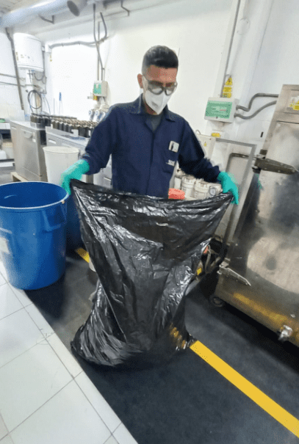





TRAINING - 5S
Zona de cuarentena
Gemba Walk

Slide 29






1S – Eliminación de innecesarios
1 S
Paso 0

Slide 30

1S – tag register
1 S

Slide 31


1S – check list
1 S
Results Check List
Antes = 31%
Después = 94%

Slide 32




2S – ORDEN
2 S
ORDER AND CLASSIFY

Slide 33


Before
After
Organization and subdivision of shelves
Order and cleanliness of the spaces and implementation of guards on the shelves.
Cleanliness, order and signaling within the Washing area

Slide 34


2S – check list
2 S
Results Check List
Antes = 33%
Después = 80%

Slide 35





CoUNTERMEASURE - TAG
Safety TAG’s
Identification of all anomalies and safety problems(UA & UC).
Reports of unsafe acts and conditions are reported in the INTELEX APP
Paso 1
Paso 2
Paso 3
Paso 4
Paso 5
Paso 6
Paso 7

Slide 36

CoUNTERMEASURE - TAG

Slide 37


3S – check list
3 S
Results Check List
Antes = 57 %
Después = 100 %

Slide 38

3S – check list
3 S
El check list se realiza de manera diaria en el área modelo.

Slide 39
METHODOLOGY- 7 Step APPROACH

Slide 40
Step 1:UNSAFE ACT/ UNSAFE CONDITION

Slide 41


SAFETY EWO
SCAT
S-EWO
BEFORE
AFTER
Why have we implemented S-EWO ?
Facilitate the description and analysis of accidents, first aid treatments and near misses;
Thoroughly investigate all events down to the true root causes; Implement the appropriate countermeasures avoiding repetitions and adequately extend them to similar areas.

Slide 42



S-EWO accident análisis – event JUNIO 2022
At approximately 3:38 p.m. on 06/20/2022, the EHS Laboratory Assistant, while performing analysis of oils and fats in the mass area, at the time of reading, moves his arm to enter the data on the computer, he touches a vial containing solvent and when it falls, it spills the mixture on the worktable, the product splashes from the height of his right leg, coming into contact with his uniform.
S-EWO
The S-EWO analysis shows that the worker does not know about the use of containment trays when is reading samples in vials with the IR. The root cause was UC – Procedures Systems, Security practices and procedures not defined.
PLAN
CHECK
ACT
DO

Slide 43

COUNTERMEASURES – s-ewo
PROPUESTA DE MEJORA

Slide 44
METHODOLOGY- 7 Step APPROACH

Slide 45

CoUNTERMEASURE – TAG – QUICK KAIZEN

Slide 46
COUNTERMEASURES - EXAMPLE OPL

Slide 47

CoUNTERMEASURE – TAG – QUICK KAIZEN

Slide 48
COUNTERMEASURES - EXAMPLE SOP

Slide 49

3.1 SWOT
Sistema de gestion de la seguridad sólido con constantes auditorías.
Personal capacitado de manera presencial y virtual.
Casuística de eventos en las charla de inicio de labores.
Acceso a la información y/o aplicativos a todo el personal de manera rápida.
Los colaboradores tienen la facultad de poder detener trabajos inseguros.
Epp de óptima Calidad.
Cultura de los colaboradores: falta de motivación e involucramiento del personal en temas de seguridad.
Involucrar hasta el MD-5 para las actividades SSMA.
Optimización de los procesos manuales.
Campañas de sensibilización al personal sobre temas de accidentabilidad.
Posicionarse como una empresa más Segura.
Rotación de personal.
Alzas de muestras en el laboratorio con corto tiempo de reportabilidad.
Covid-19
Influencia negativa del entorno en la toma de decisiones seguras.
Notes:
Heavier content slide.

Slide 50

3.1 STEPS
Risk Assessment
Risk Prediction
Última Slide, tabla de resultados
KPI/KAI
Implementación de Proyectos de mejora enfocados a reducir los índices de accidentabilidad
Involucrar a todos los colaboradores en la implementación WCS.
Culminar con la implementación de las 5 s en el área modelo
Notes:
Heavier content slide.

